Slide 1
Conference on the Future of Europe – Event on Indoor Air Quality
EU Policies on Indoor Air Quality
Stylianos Kephalopoulos,
European Commission Joint Research Centre (JRC)

Slide 2
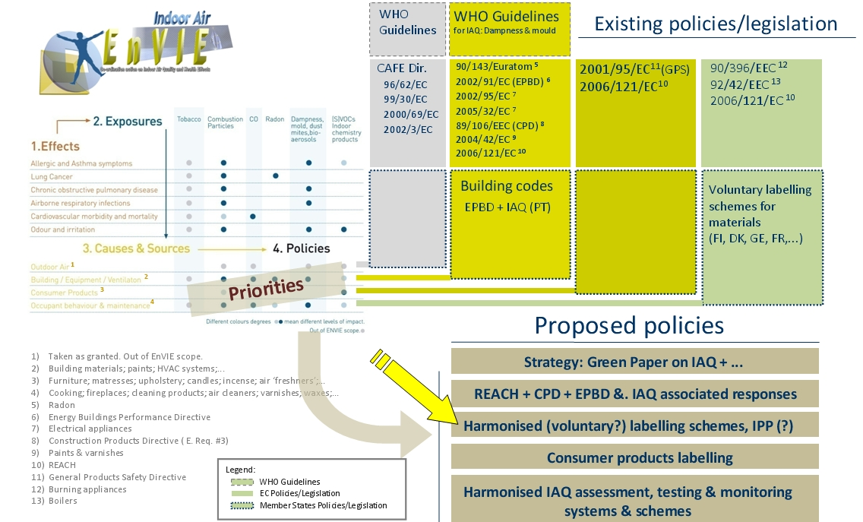

DG SANCO’s IAIAQ: Impact Assessment of IAQ related policies, actions and projects (2010-2011)
Partners:
KTL-FI, UMIL-IT, UPORTO-PT, JRC
Only few policies could reach as much as half of their potentials by 2020; others only one fourth
More than half of the DALYs lost today due to indoor air exposures could ultimately be
prevented by the assessed policies.
Notes:
Launched in 2015

Slide 3
IAQ associated BoD in kDALY/yr attributed to diseases in total 2.2 MDALY/yr, excluding ETS
IAQ associated BoD in DALY/yr attributed to
sources of exposure
IAQ associated BoD in kDALY/yr attributed to
exposure agents
Source: DG SANCO’s IAIAQ project (2010-2011):
Impact Assessment of IAQ related policies, actions and projects
Notes:
Launched in 2015

Slide 4
Potential health benefits at the 10th year of implementation of
10 IAQ related policies in 26 European Countries, DALYs/year
Notes:
Launched in 2015

Slide 5
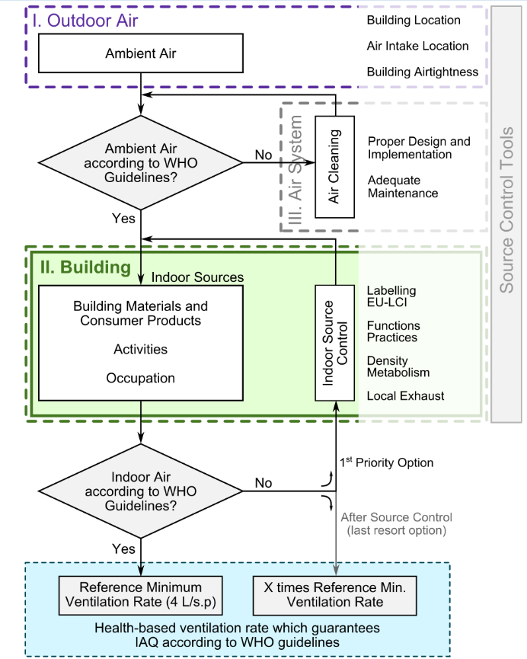
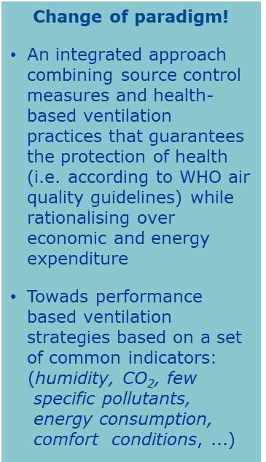
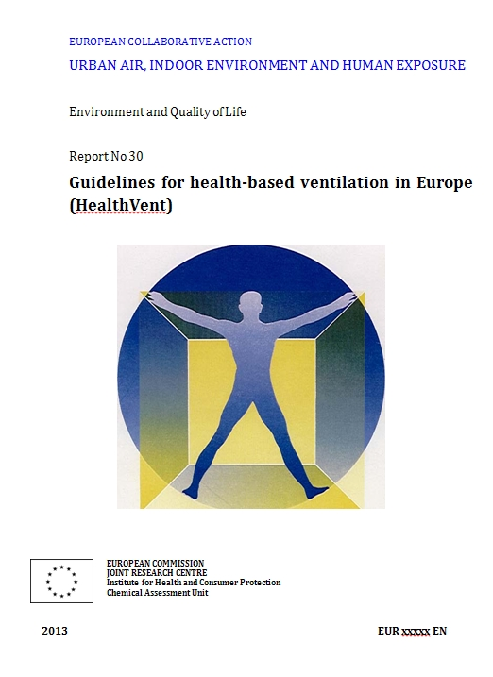
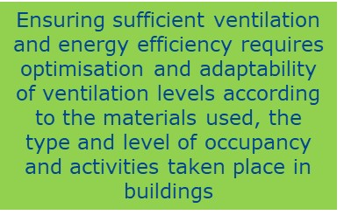
Guidelines for health-based ventilation in EU (HEALTHVENT)
JRC ECA report n. 30 (2015)
Notes:
Launched in 2015

Slide 6
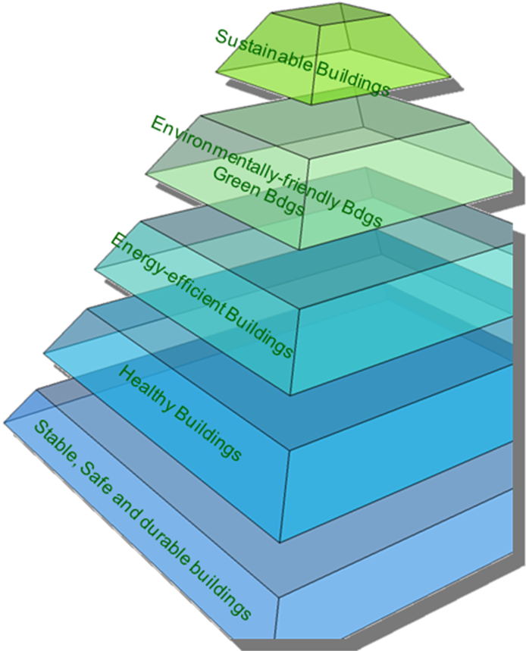
The need for a holistic approach for better aligning and integrating policies, regulations and standards related to the built environment which cross-cutting the issues of safety, health, energy efficiency and sustainability
The need for a holistic approach
Cross-cutting Directives & Related Standards
EPBD Recast (2010/31/EC)
Energy Performance of Buildings Directive
CPR (2011/305/EC)
Construction Products Regulation
Eco-design Directive
Energy Labelling Directive, Ecolabel
…..
Notes:
Launched in 2015

Slide 7
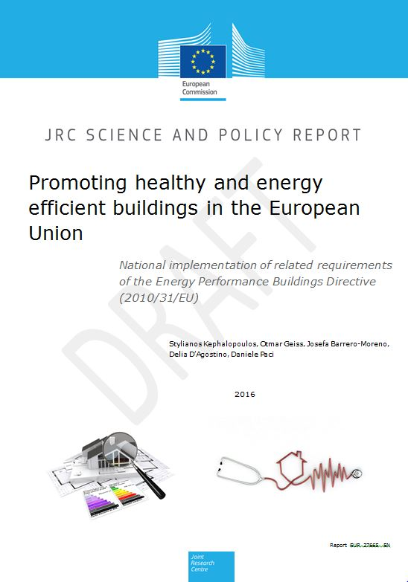
JRC report on Task 13.3 of DG ENER project on EED and EPBD assessment
JRC staff members
Stylianos KEPHALOPOULOS, Otmar GEISS, Josefa BARRERO-MORENO, Delia D’AGOSTINO, Daniele PACI
Advisory Board of Experts
Francis ALLARD, Université de la Rochelle, France
Paolo CARRER, Milan University, Italy
Derrick CRUMP, IEH Consulting Limited, United Kingdom
Anita DERJANECZ, REHVA, Belgium
Eduardo DE OLIVEIRA FERNANDES, Porto University, Portugal
Otto HÄNNINEN, National Institute for Health and Welfare, Finland
Dorota JAROSINSKA, World Health Organisation (WHO), Germany
Jarek KURNITSKI, Tallinn University of Technology, Estonia
Hugo SANTOS, Porto University, Portugal
Corinne MANDIN, CSTB, France
Bjarne OLESEN, Danish Technical University, Denmark
Olli SEPPÄNEN, REHVA, Belgium
Pawel WARGOCKI, Danish Technical University, Denmark
Peter WOUTERS, Belgian Building Research Institute, Belgium
https://ec.europa.eu/jrc/en/publication/eur-scientific-and-technical-research-reports/promoting-healthy-and-energy-efficient-buildings-european-union-national-implementation
Notes:
Launched in 2015

Slide 8
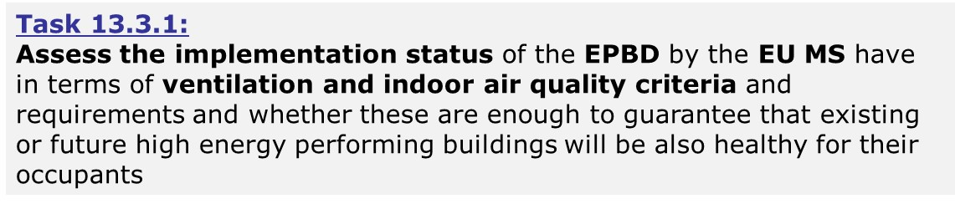
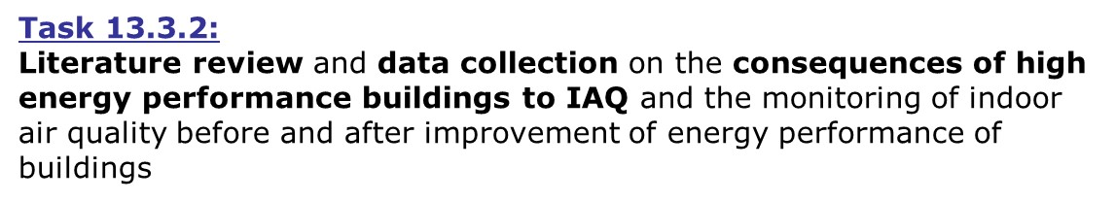
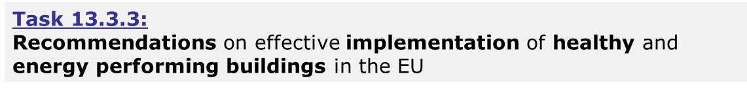
JRC report on Task 13.3 of DG ENER project on EED and EPBD assessment
Notes:
Launched in 2015

Slide 9
JRC report on Task 13.3 of DG ENER project on EED and EPBD assessment
Highlighted recommendations
A co-ordinated and coherent implementation of IEQ related requirements in building related policies in EU is still missing as from a regulatory point of view this remains under the competencies and responsibilities of the EU Member States with no binding requirements at EU level. This creates obstacles for the implementation of an integrated performance-based approach for buildings’ related energy and IEQ issues in Europe.
There is a need to provide common health-based ventilation guidance in Europe, that will reinforce the definition and setting of ventilation requirements and metrics based on health criteria to be applied after all possible control strategies of indoor and outdoor pollution sources have been exploited.
Notes:
Launched in 2015

Slide 10
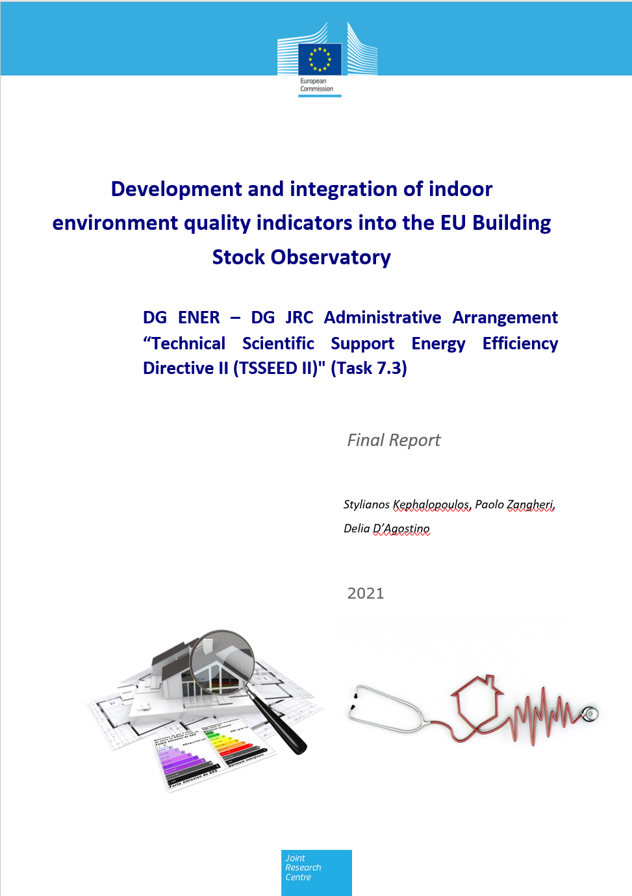
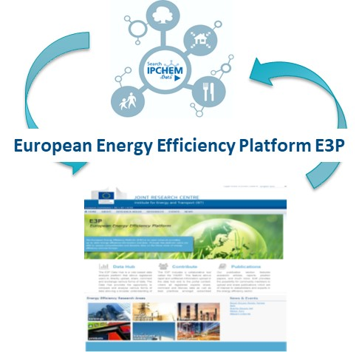
Development and integration of Indoor Environmental Quality indicators into the EU Building Stock Observatory
Notes:
How does IPCHEM contribute
Unique source for exploring chemical occurrence data across different media covering human biomonitoring, and monitoring of environmental media, consumer products and indoor air; and food and feed;
IPCHEM includes data for more than 3000 substances and 450 mio concentration measurements
The most data rich areas are the environmental monitoring and f&f monitoring, but also the other areas are expected to increase considerably in the near future
This is only possible thanks to the openness and willingness to share data by our data providers, which are EU institutions and agencies, MS authorities, and research projects, with whom we collaborate as partners to further develop and improve IPCHEM
Click for animation→
Apart from the volume of data available, the big benefit to the users is that they can gather data from across media via a single platform
Data integrated in IPCHEM are harmonised for the most relevant parameters and quality checked
We always publish Metadata (summaries) describing the data collections, such as the monitoring purpose, links to additional references and a contact point, allowing direct interaction with data providers for questions of data interpretation.
Most datasets (around 70%) are publicly available, in some cases access is restricted because of e.g. data protection rules.

Slide 11

IPCHEM The reference platform for chemical monitoring data in Europe
https://ipchem.jrc.ec.europa.eu
Single access point for searching, accessing and retrieving chemical occurrence data collected and managed in Europe and beyond
The platform has been developed to fill the knowledge gap on chemical exposure and its burden on health and the environment
Notes:
Launched in 2015

Slide 12
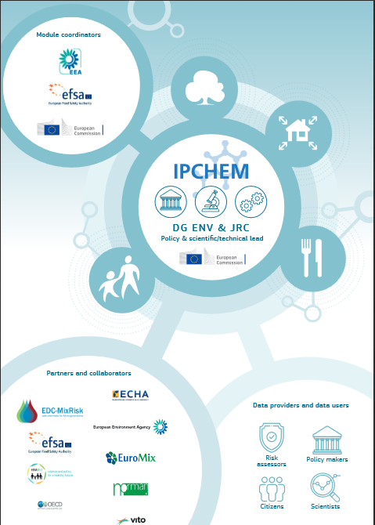
Our partners and users
IPCHEM is a collaborative project
Policy Lead: DG Environment
Scientific/Technical Lead: JRC
Module coordinators, collaborators and partners: EEA, EFSA, ECHA, MS authorities, research projects
Data providers: Agencies, MSs, research projects
Data used for: risk assessment, policy making, research…
Notes:
IPCHEM is a collaborative project, working with many different partners, including data providers and data users, researchers, policy makers
Uses:
Monitoring time and spatial trends
Risk/impact indicators
Monitoring compliance and targeting intervention
Impact of regulatory intervention
Regulatory risk assessments

Slide 13
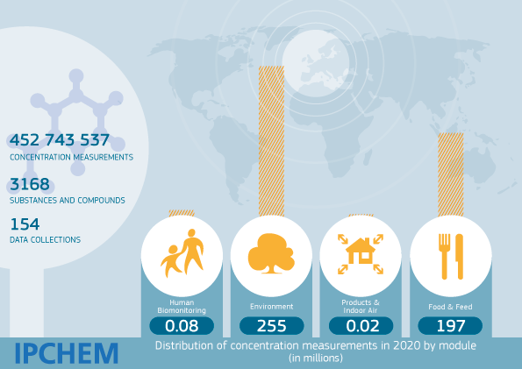



Four IPCHEM thematic modules, one on IAQ
Harmonised & quality checked
Metadata & contact point
Share data publicly
Notes:
How does IPCHEM contribute
Unique source for exploring chemical occurrence data across different media covering human biomonitoring, and monitoring of environmental media, consumer products and indoor air; and food and feed;
IPCHEM includes data for more than 3000 substances and 450 mio concentration measurements
The most data rich areas are the environmental monitoring and f&f monitoring, but also the other areas are expected to increase considerably in the near future
This is only possible thanks to the openness and willingness to share data by our data providers, which are EU institutions and agencies, MS authorities, and research projects, with whom we collaborate as partners to further develop and improve IPCHEM
Click for animation→
Apart from the volume of data available, the big benefit to the users is that they can gather data from across media via a single platform
Data integrated in IPCHEM are harmonised for the most relevant parameters and quality checked
We always publish Metadata (summaries) describing the data collections, such as the monitoring purpose, links to additional references and a contact point, allowing direct interaction with data providers for questions of data interpretation.
Most datasets (around 70%) are publicly available, in some cases access is restricted because of e.g. data protection rules.

Slide 14
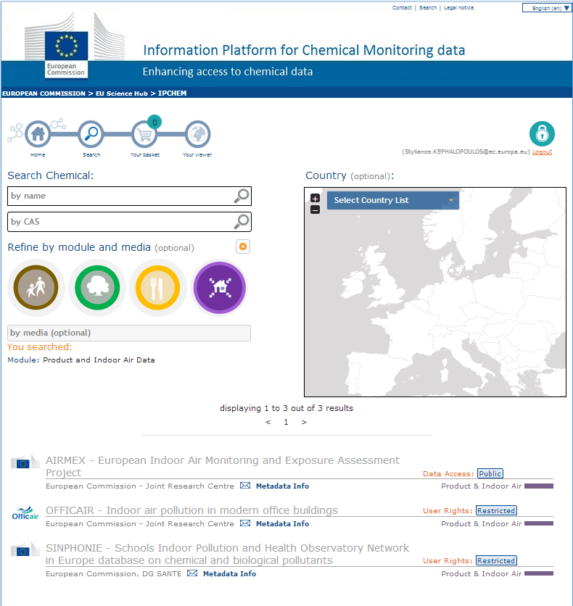
IPCHEM Thematic Module IV: Data Integration Status
AIRMEX - European Indoor Air Monitoring and Exposure Assessment Project
27 chemicals
9 EU Countries
8.487 SINGLE concentration measurements
OFFICAIR - Indoor air pollution in modern office buildings
33 chemicals
7 EU Countries
11.156 SINGLE concentration measurements
SINPHONIE - Schools Indoor Pollution and Health Observatory Network in Europe database on chemical and biological pollutants
11 chemicals
22 EU Countries
2165 SINGLE concentration measurements
Notes:
How does IPCHEM contribute
Unique source for exploring chemical occurrence data across different media covering human biomonitoring, and monitoring of environmental media, consumer products and indoor air; and food and feed;
IPCHEM includes data for more than 3000 substances and 450 mio concentration measurements
The most data rich areas are the environmental monitoring and f&f monitoring, but also the other areas are expected to increase considerably in the near future
This is only possible thanks to the openness and willingness to share data by our data providers, which are EU institutions and agencies, MS authorities, and research projects, with whom we collaborate as partners to further develop and improve IPCHEM
Click for animation→
Apart from the volume of data available, the big benefit to the users is that they can gather data from across media via a single platform
Data integrated in IPCHEM are harmonised for the most relevant parameters and quality checked
We always publish Metadata (summaries) describing the data collections, such as the monitoring purpose, links to additional references and a contact point, allowing direct interaction with data providers for questions of data interpretation.
Most datasets (around 70%) are publicly available, in some cases access is restricted because of e.g. data protection rules.

Slide 15
Thank you

